Slide 1
COMPUTER NETWORK AND COMMUNICATION CND3200 Topic 2: TCP/IP&Cloud Services
1

Slide 2
TCP/IP Protocol Suite
Developed prior to the OSI model
5 layers – also known Internet model
The three topmost layers in the OSI model are represented in TCP/IP by a single layer – application layer
TCP/IP is a hierarchical protocol – the upper-level protocol is supported by one or more lower-level protocols
E.g.: @ TL – TCP, UDP; @NL - IP
2

Slide 3
TCP/IP
Physical layer
Twisted pair, optical fibers, satellite
Data link layer
Ethernet, WiFi
Network layer
IP
Transport layer
TCP, UDP, SCTP
Application Layer
SMTP, FTP
3

Slide 4
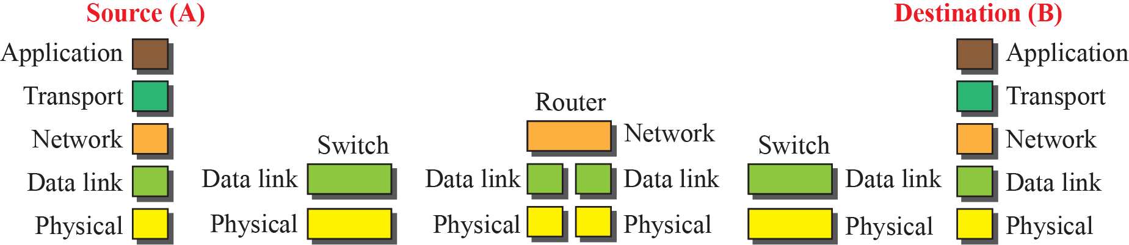

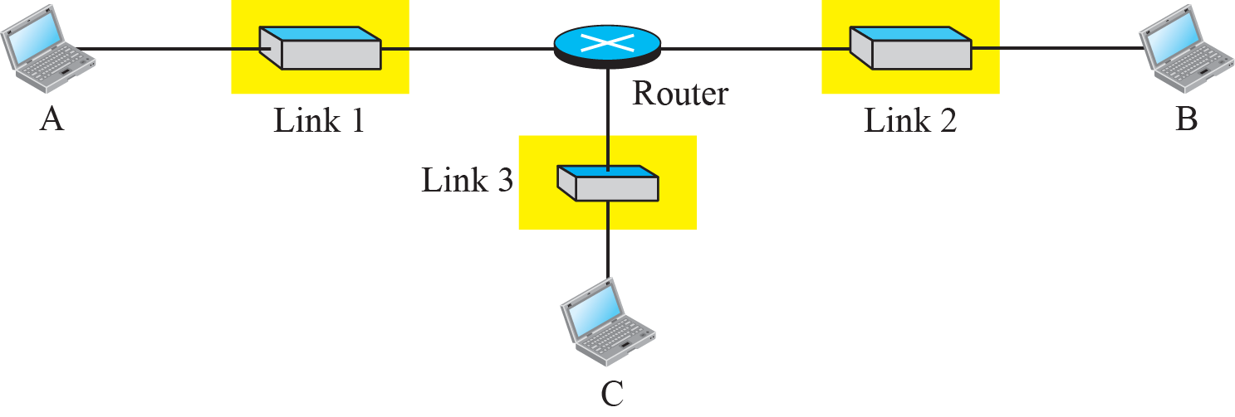
Figure : Communication through an internet (Forouzan, 2013)
To show how the layers in the TCP/IP protocol suite are involved in communication between two hosts
Eg: small internet made up of three LANs (links), each with a link-layer switch. The links are connected by one router
1.4
Notes:
1.#

Slide 5
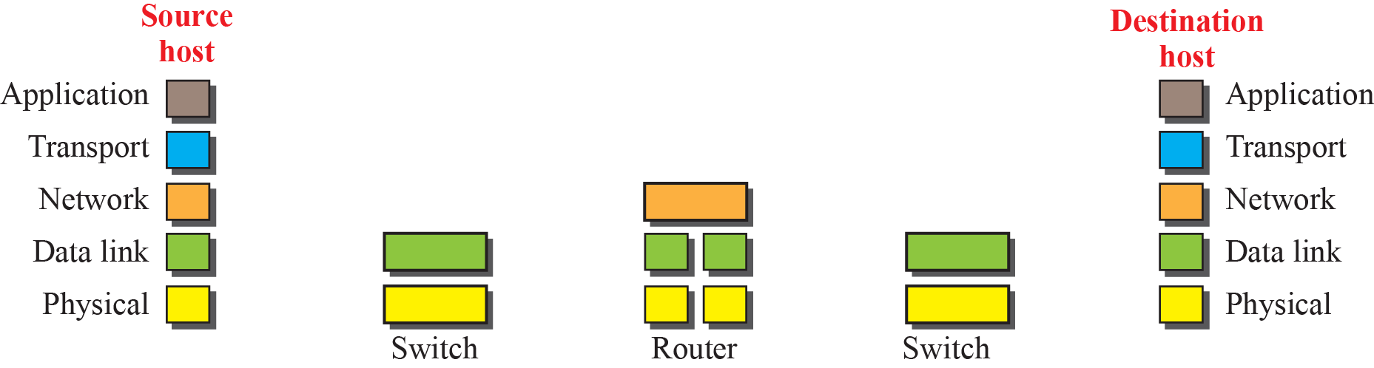
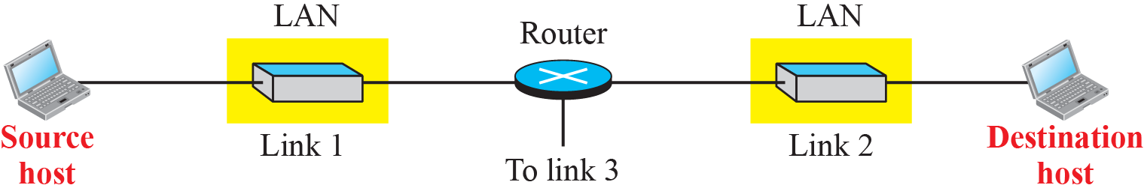
Figure : Logical connections between layers in TCP/IP (Forouzan, 2013)
Logical connections
1.5
Notes:
1.#

Slide 6
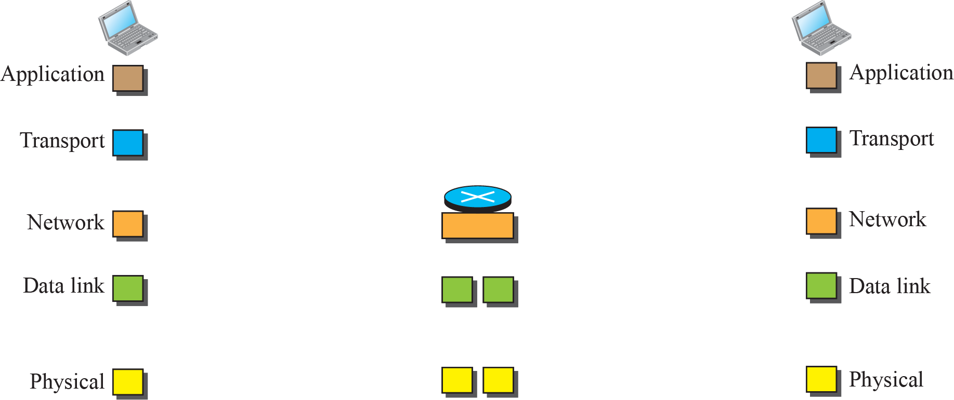
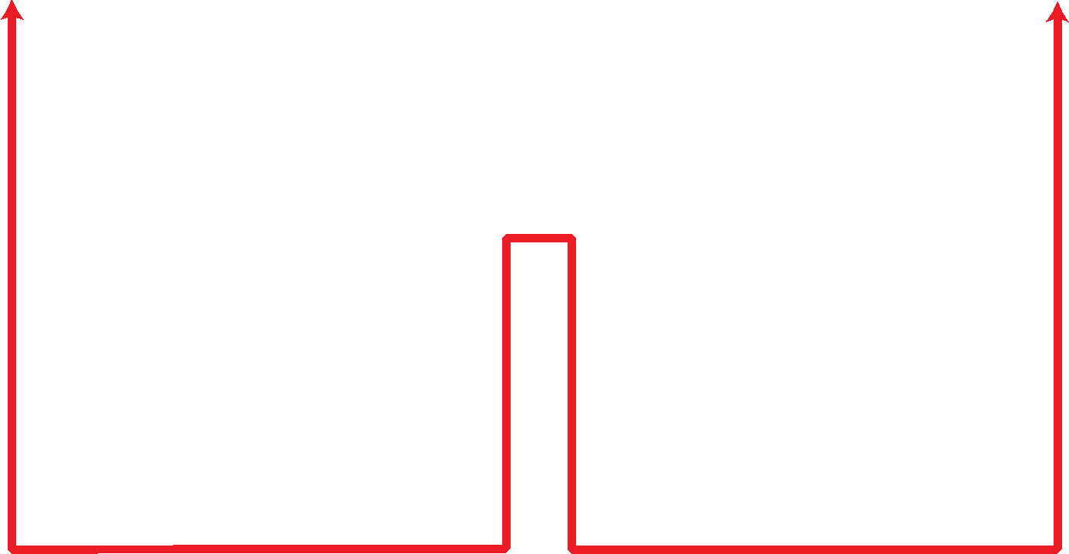
Figure : Identical objects in the TCP/IP protocol suite (Forouzan, 2013)
Identical objects (messages)
Identical objects (segment or user datagram)
Identical objects (datagram)
Identical objects (datagram)
Identical objects (frame)
Identical objects (frame)
Identical objects (bits)
Identical objects (bits)
1.6
Notes:
1.#

Slide 7
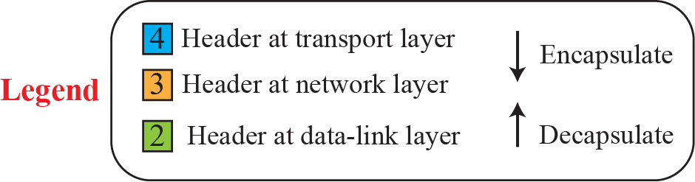
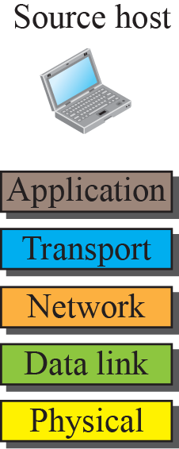
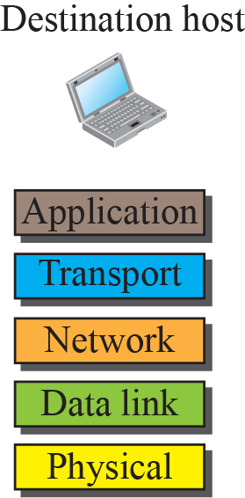
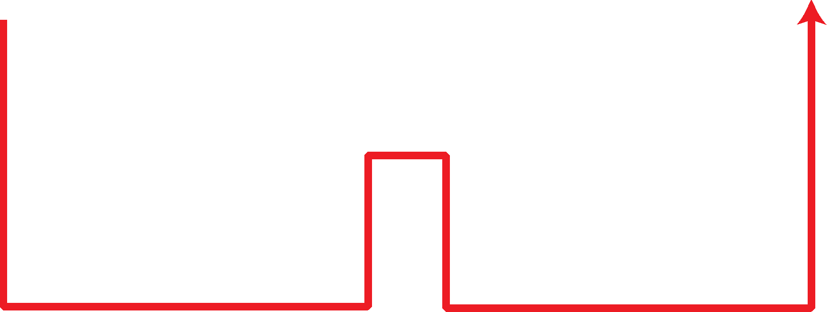
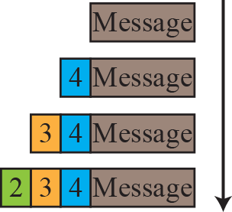
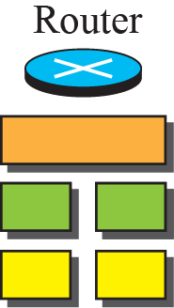
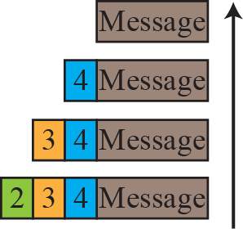
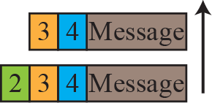
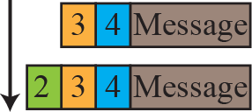
Figure : Encapsulation / Decapsulation (Forouzan, 2013)
One of the important concepts in protocol layering in the Internet is encapsulation/ decapsulation.
1.7
Notes:
1.#

Slide 8
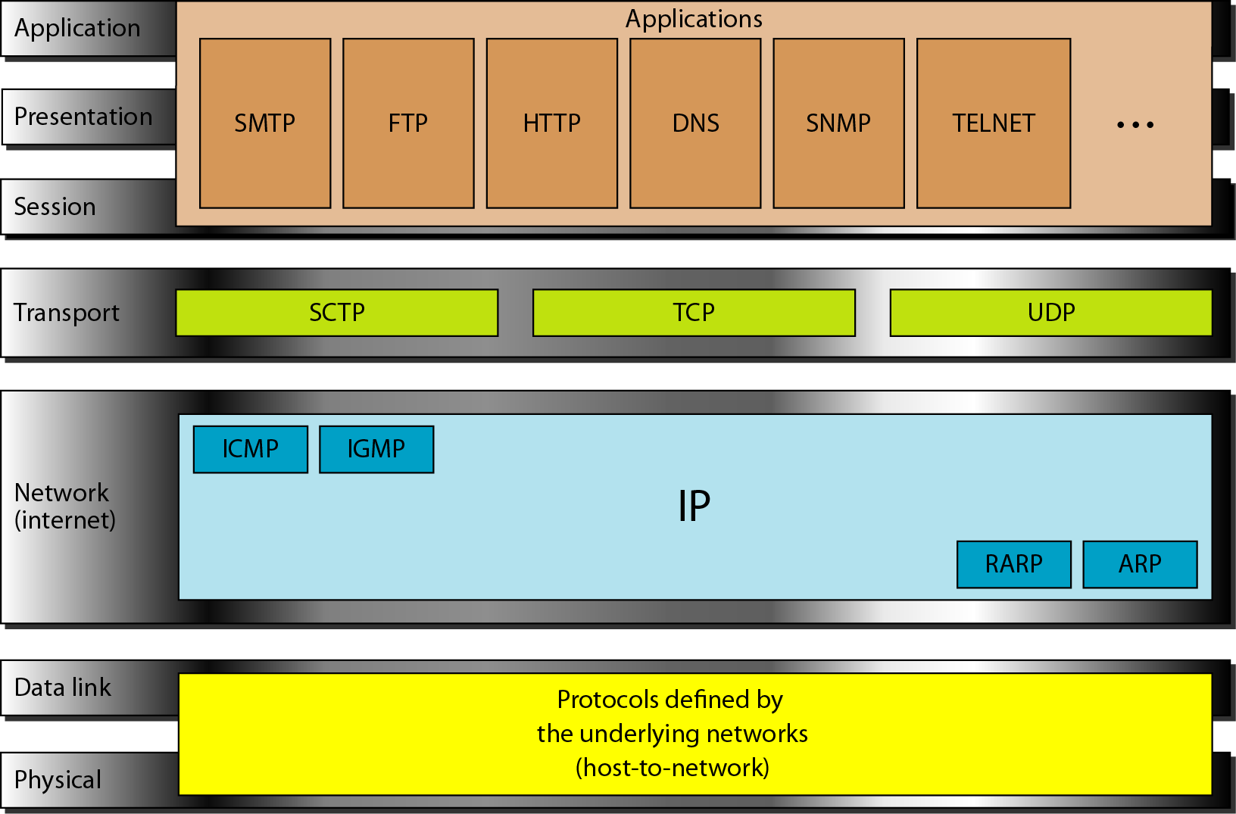
Figure 2.16 TCP/IP and OSI model
Notes:
8

Slide 9
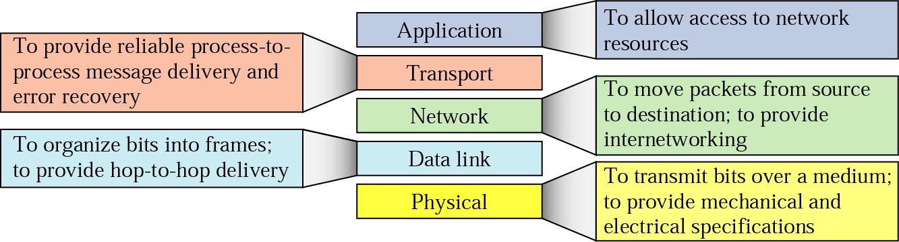
Summary of Layer Functions (TCP/IP)
9

Slide 10
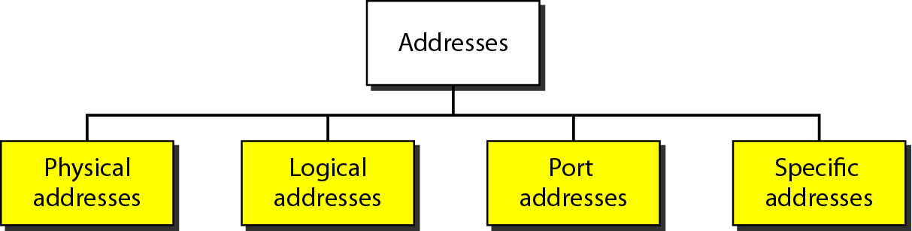
Example of using TCP/IP
Prior to the example, you need to know the following terminologies in which will mapped to the TCP/IP model
Addresses in TCP/IP
2.10
Notes:
10

Slide 11
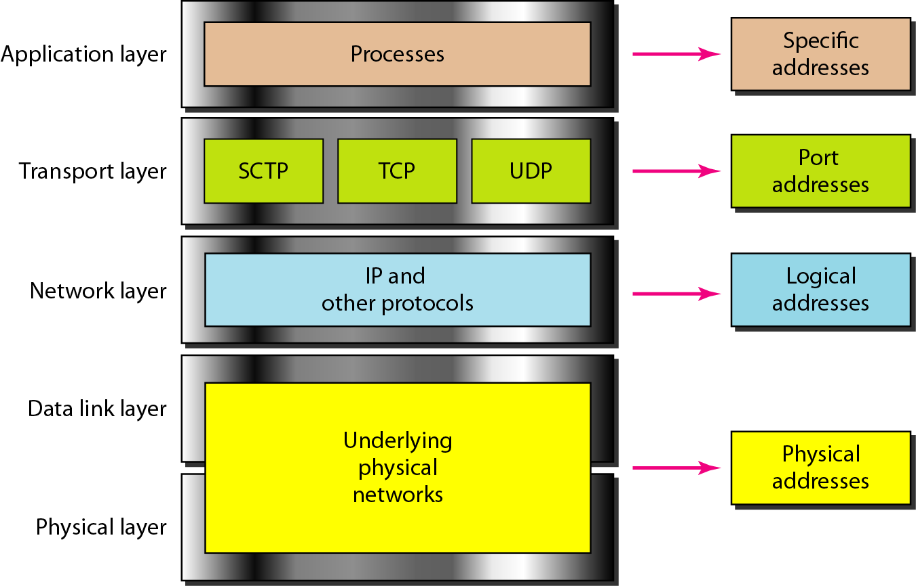
Relationship of layers and addresses in TCP/IP
Notes:
11

Slide 12
Discussion, Q&A
Match the following to one or more layers of the OSI Model :
Route determination
Connection to transmission media
Providing services for the end user
Creating user datagrams
Transforming bits to electromagnetic signals
Responsibility for handling frames between adjacent nodes
What are types of address used in each of the following layers in the TCP/IP protocol?
Data link layer, network layer, application layer
12

Slide 13
2.2 Cloud Services
Cloud definition
Cloud computing is a model for enabling convenient, on-demand network access to a shared pool of configurable computing resources (e.g., networks, servers, storage, applications, and services) that can be rapidly provisioned and released with minimal management effort or service provider interaction (National Institute of Standards and Technology).
This cloud model promotes availability and is composed of five essential characteristics, three service models, and four deployment models.
13
Notes:
Lecture notes
*
13

Slide 14
2.2 Cloud Services (cont..)
Cloud computing is Internet-based computing, whereby shared resources, software, and information are provided to computers and other devices on demand, like the electricity grid. Cloud computing is a style of computing in which dynamically scalable and often virtualized resources are provided as a service over the Internet. (Wikipedia)
Cloud is a type of parallel and distributed system consisting of a collection of interconnected and virtualized computers that are dynamically provisioned and presented as one or more unified computing resources based on service-level agreements established through negotiation between the service provider and consumers.(Buyya)
14
Notes:
Lecture notes
*
14

Slide 15
2.2 Cloud Services (cont..)
Analogy - moved to a city and looking for a place to live. Your choice :
Built a new house ? fully control everything your like your new house to have. But that is a hard work …
Buy an empty house ? can customize some part of your house. But never change the original architecture.
Live in a hotel ? Live in a hotel will be a good idea if the only thing you care is enjoy your life!! There is nothing you can do with the house except living in it.

Slide 16
2.2 Cloud Services (cont..)
Service Models Overview
Scenario - What if you want to have an IT department ?
Infrastructure as a Service (IaaS) - build a new house?
•You can rent some virtualized infrastructure and build up your own IT system among those resources, which may be fully controlled.
Platform as a Service (PaaS) - buy an empty house?
•You can directly develop your IT system through one cloud platform, and do not care about any lower level resource management.
Software as a Service (SaaS) Similar to live in a hotel?
•You can directly use some existed IT system solutions, which were provided by some cloud application service provider, without knowing any detail technique about how these service was achieved.

Slide 17
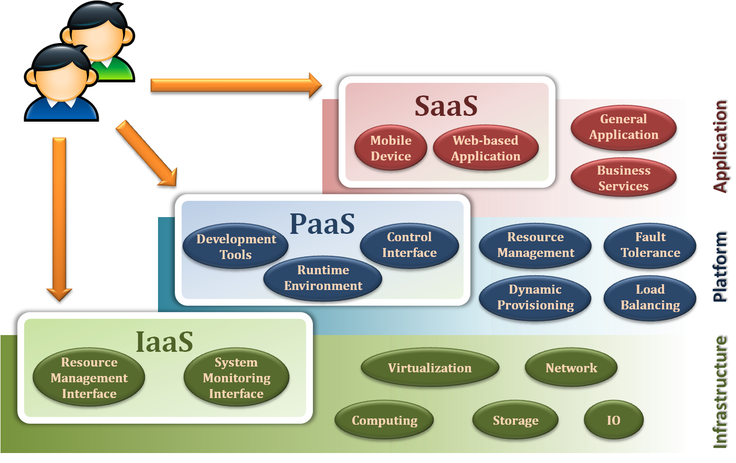
2.2 Cloud Services (cont..)

Slide 18
Infrastructure as a Service
Infrastructure as a Service - IaaS
The capability provided to the consumer is to provision processing, storage, networks, and other fundamental computing resources where the consumer is able to deploy and run arbitrary software, which can include operating systems and applications.
The consumer does not manage or control the underlying cloud infrastructure but has control over operating systems, storage, deployed applications, and possibly limited control of select networking components .
Examples :
Amazon EC2
Eucalyputs
OpenNebula
… etc

Slide 19
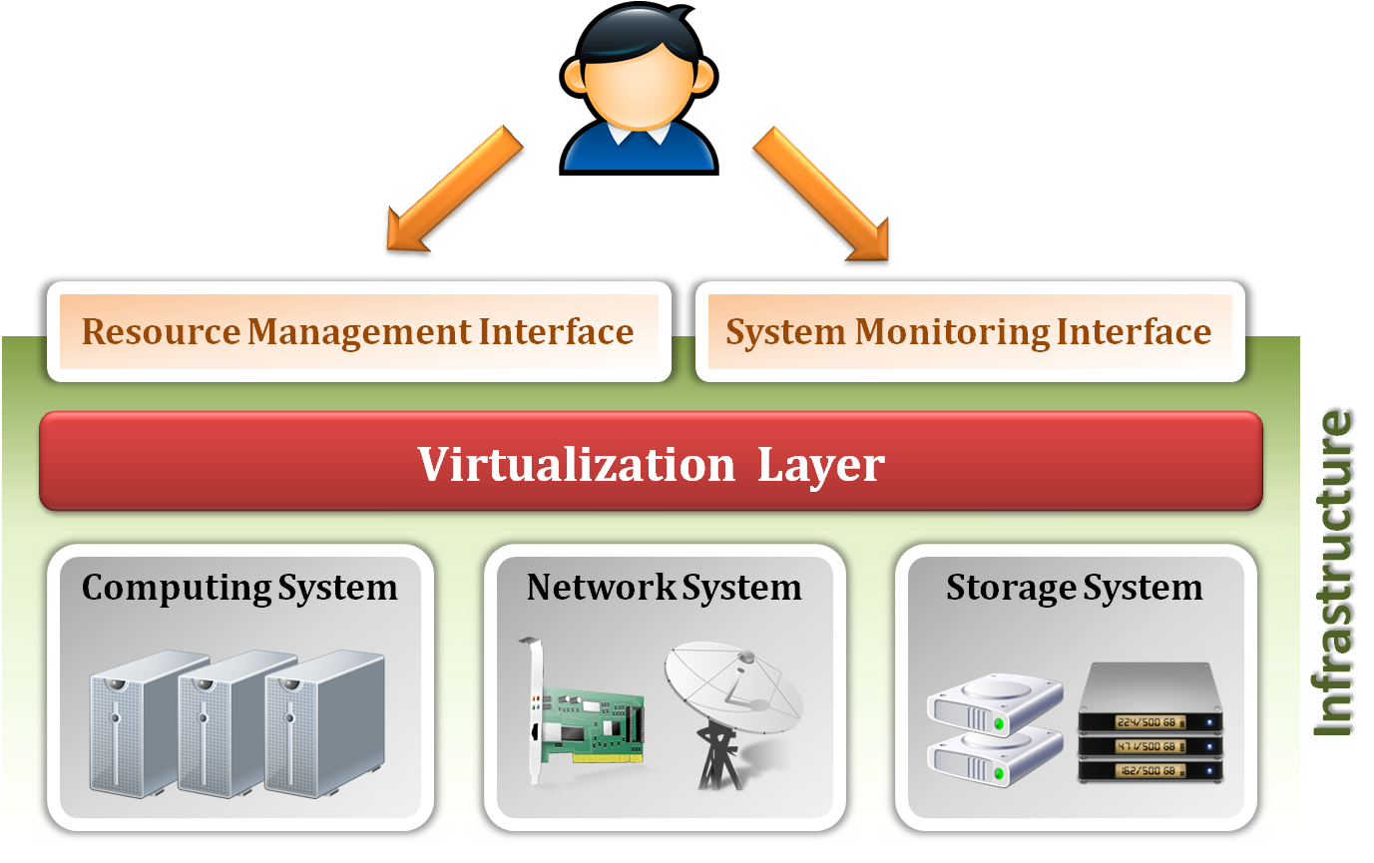
Infrastructure as a Service
System architecture :

Slide 20
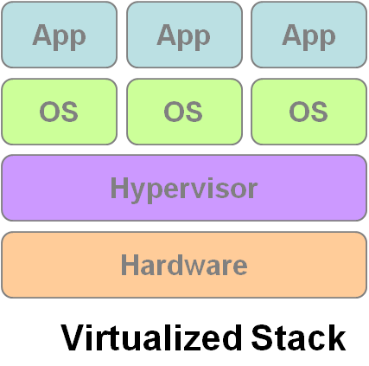
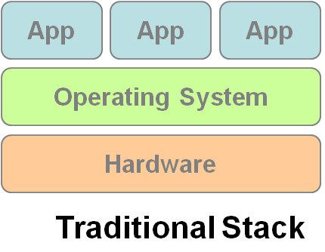
Infrastructure as a Service
Enabling technique - Virtualization
Virtualization is an abstraction of logical resources away from underlying physical resources.
Virtualization technique shift OS onto hypervisor.
Multiple OS share the physical hardware and provide different services.
Improve utilization, availability, security and convenience.
VM1
VM2
VM3

Slide 21
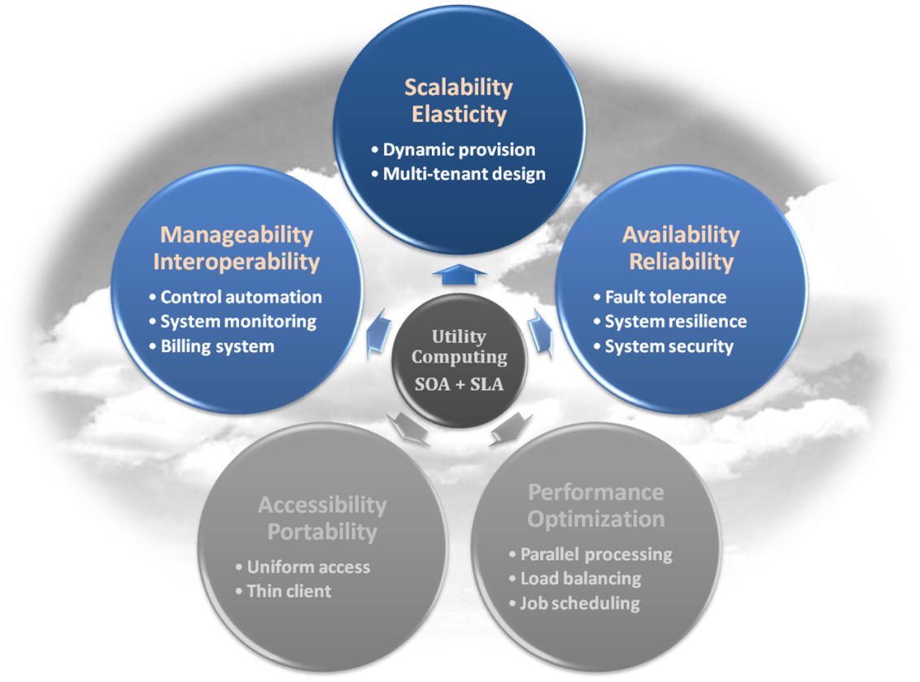
Infrastructure as a Service
Properties supported by virtualization technique :
Manageability and Interoperability
Availability and Reliability
Scalability and Elasticity

Slide 22
Infrastructure as a Service
Provide service –Resource Management Interface
Several types of virtualized resource :
Virtual Machine – As an IaaS provider, we should be able to provide the basic virtual machine operations, such as creation, suspension, resumption and termination, …etc.
Virtual Storage – As an IaaS provider, we should be able to provide the basic virtual storage operations, such as space allocation, space release, data writing and data reading, …etc.
Virtual Network – As an IaaS provider, we should be able to provide the basic virtual network operations, such as IP address allocation, domain name register, connection establishment and bandwidth provision, …etc.

Slide 23
Infrastructure as a Service
Provide service – System Monitoring Interface
Several types of monitoring metrics :
Virtual Machine – As an IaaS provider, we should be able to monitor some system states of each virtual machine, such as CPU loading, memory utilization, IO loading and internal network loading, …etc.
Virtual Storage – As an IaaS provider, we should be able to monitor some storage states of each virtual storage, such as virtual space utilization, data duplication and storage device access bandwidth, …etc.
Virtual Network – As an IaaS provider, we should be able to monitor some network states of each virtual network, such as virtual network bandwidth, network connectivity and network load balancing, …etc.

Slide 24
IaaS - Summary
IaaS is the deployment platform that abstract the infrastructure.
IaaS enabling technique
Virtualization
Server Virtualization
Storage Virtualization
Network Virtualization
IaaS provided services
Resource Management Interface
System Monitoring Interface

Slide 25
Platform as a Service
Platform as a Service - PaaS
The capability provided to the consumer is to deploy onto the cloud infrastructure consumer-created or acquired applications created using programming languages and tools supported by the provider.
The consumer does not manage or control the underlying cloud infrastructure including network, servers, operating systems, or storage, but has control over the deployed applications and possibly application hosting environment configurations.
Examples :
Microsoft Windows Azure
Google App Engine
Hadoop
… etc

Slide 26
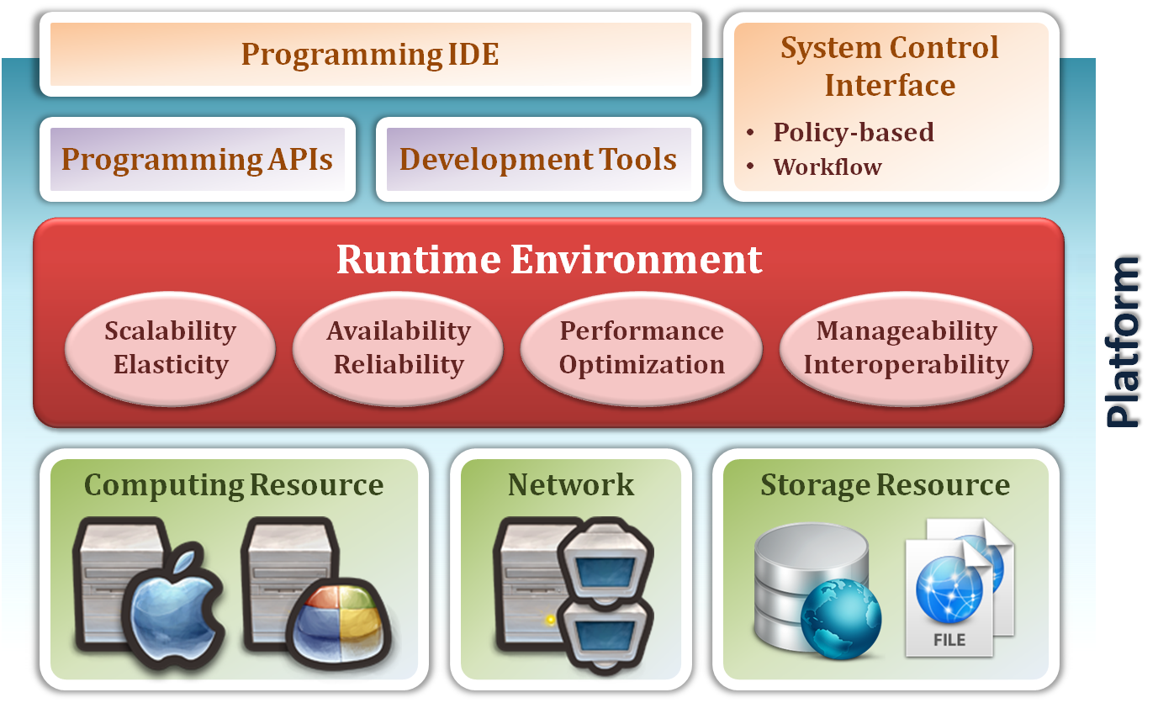
Platform as a Service
System architecture :

Slide 27
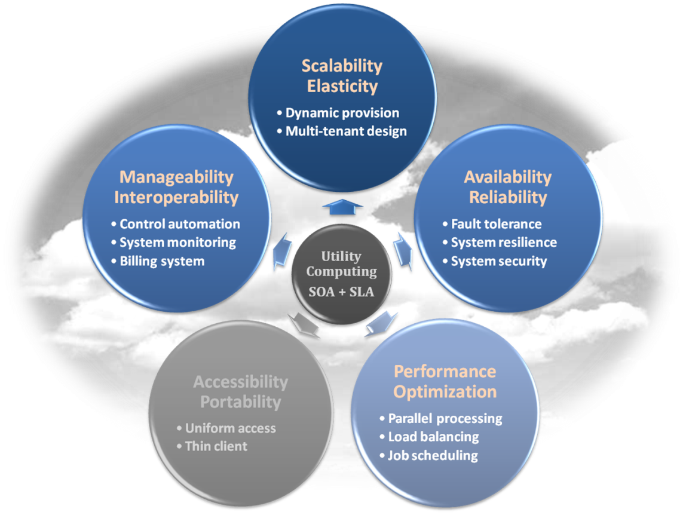
Platform as a Service
Enabling technique – Runtime Environment Design
Runtime environment refers to collection of software services available. Usually implemented by a collection of program libraries.
Common properties in Runtime Environment :
Manageability and Interoperability
Performance and Optimization
Availability and Reliability
Scalability and Elasticity

Slide 28
Platform as a Service
Provide service – Programming IDE
Users make use of programming IDE to develop their service among PaaS.
This IDE should integrate the full functionalities which supported from the underling runtime environment.
This IDE should also provide some development tools, such as profiler, debugger and testing environment.
The programming APIs supported from runtime environment may be various between different cloud providers, but there are still some common operating functions.
Computation, storage and communication resource operation

Slide 29
Platform as a Service
Provide service – System Control Interface
Policy-Based Control
Typically described as a principle or rule to guide decisions and achieve rational outcome(s)
Make the decision according to some requirements
Workflow Control
Describe the flow of installation and configuration of resources
Workflow processing daemon delivers speedy and efficient construction and management of cloud resources

Slide 30
PaaS - Summary
PaaS is the development platform that abstract the infrastructure, OS, and middleware to drive developer productivity. PaaS enabling technique
Runtime Environment PaaS provide services
Programming IDE
Programming APIs
Development tools
System Control Interface
Policy based approach
Workflow based approach

Slide 31
Software as a Service
Software as a Service - SaaS
The capability provided to the consumer is to use the provider’s applications running on a cloud infrastructure. The applications are accessible from various client devices through a thin client interface such as a web browser (e.g., web-based email).
The consumer does not manage or control the underlying cloud infrastructure including network, servers, operating systems, storage, or even individual application capabilities, with the possible exception of limited user-specific application configuration settings.
Examples :
Google Apps (e.g., Gmail, Google Docs, Google sites, …etc)
SalesForce.com
EyeOS
… etc

Slide 32
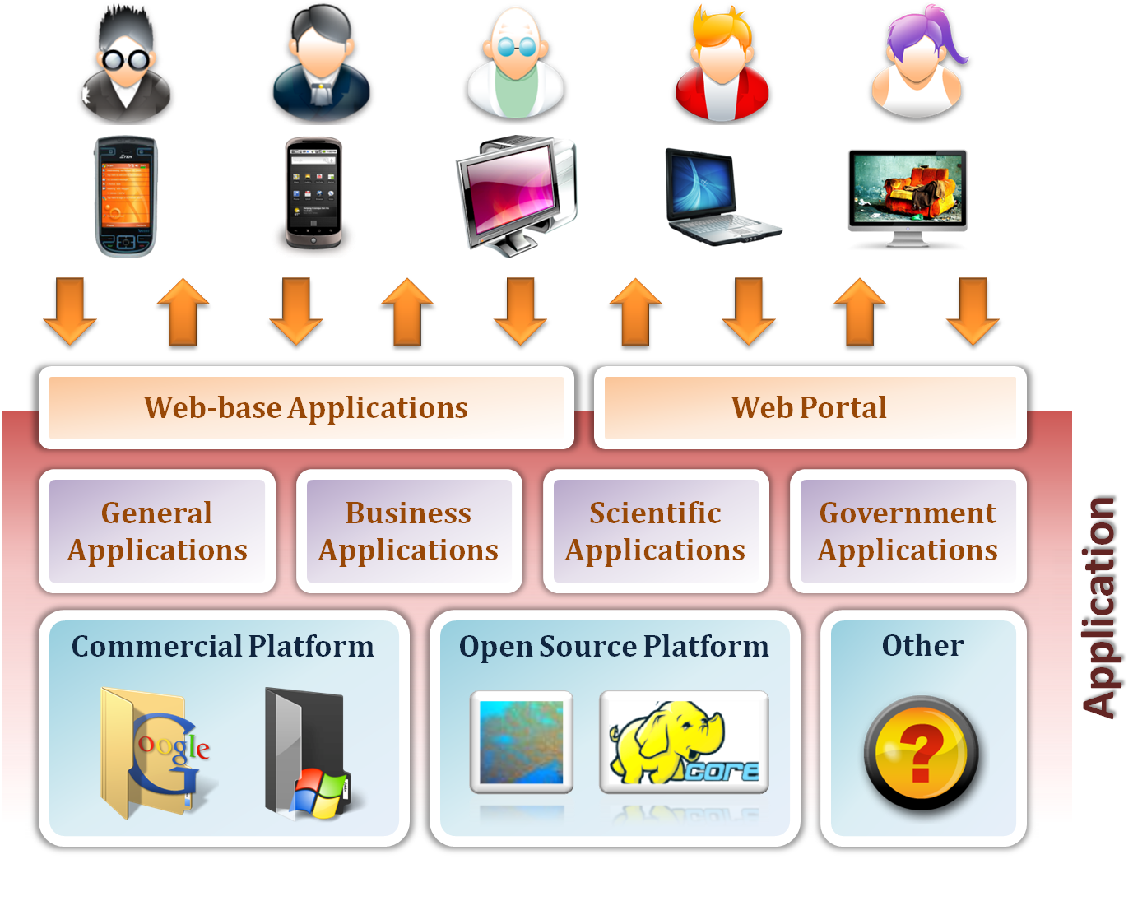
Software as a Service

Slide 33
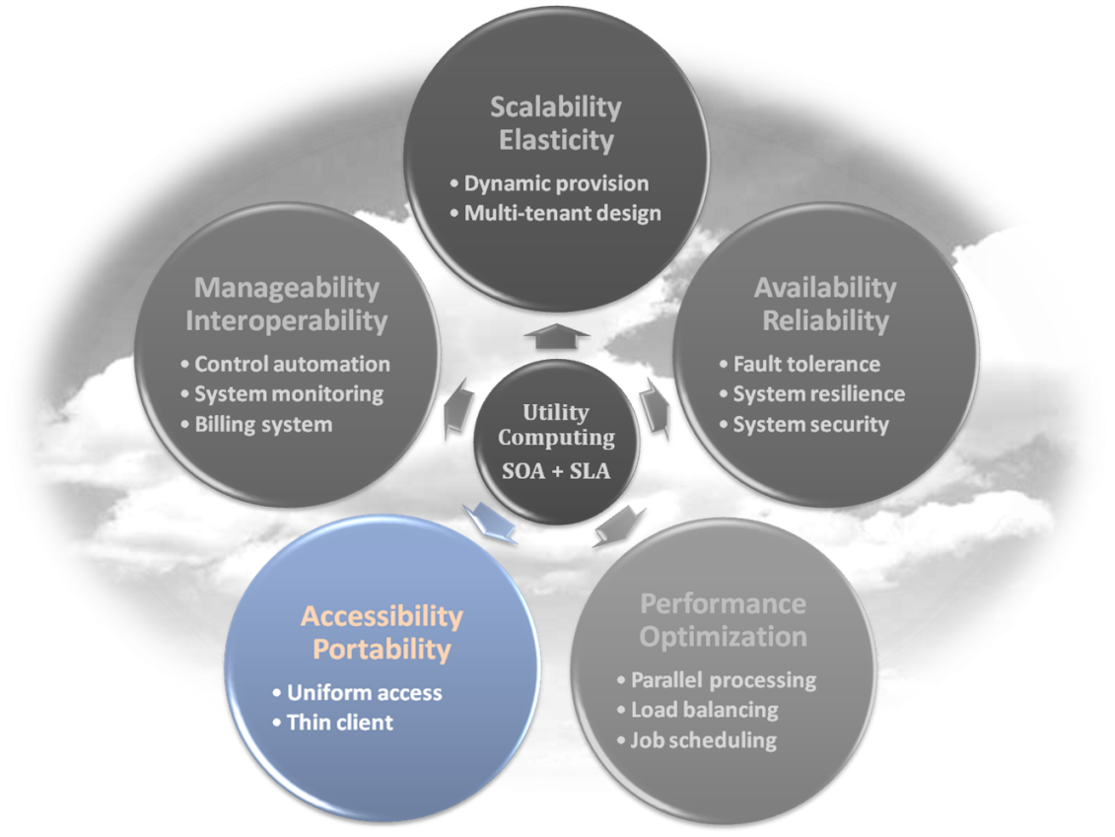
Software as a Service
Enabling Technique – Web Service
Web 2.0 is the trend of using the full potential of the web
Viewing the Internet as a computing platform
Running interactive applications through a web browser
Leveraging interconnectivity and mobility of devices
Enhanced effectiveness with greater human participation
Properties provided by Internet :
Accessibility and Portability

Slide 34
Software as a Service
Provide service – Web-based Applications
Conventional applications should translate their access interface onto web-based platform.
Applications in different domains
General Applications – Applications which are designed for general purpose, such as office suit, multimedia and instant message, …etc.
Business Applications – Application which are designed for business purpose, such as ERP, CRM and market trading system, …etc.
Scientific Applications – Application which are designed for scientific purpose, such as aerospace simulation and biochemistry simulation, …etc.
Government Applications – Applications which are designed for government purpose, such as national medical system and public transportation system service, …etc.

Slide 35
Software as a Service
Provide service – Web Portal
Apart from the standard search engine feature, web portals offer other services such as e-mail, news, stock prices, information, databases and entertainment.
Portals provide a way for enterprises to provide a consistent look and feel with access control and procedures for multiple applications and databases, which otherwise would have been different entities altogether.
Some examples :
iGoogle
MSNBC
Netvibes
Yahoo!

Slide 36
SaaS - Summary
SaaS is the finished applications that you rent and customize.
SaaS enabling technique
Web Service
SaaS provide services
Web-based Applications
General applications
Business applications
Scientific applications
Government applications
Web Portal

Slide 37
2.3 OSI and Cloud Layers

Slide 38
2.3 OSI and Cloud Layers (cont..)

Slide 39
2.3 OSI and Cloud Layers (cont..)

Slide 40
2.3 OSI and Cloud Layers (cont..)

Slide 41
2.3 OSI and Cloud Layers (cont..)

Slide 42
2.3 OSI and Cloud Layers (cont..)

